Slide 1
Real Time Resource Monitoring System
TEAM MEMBERS
Tatvam (B20CS077)
Maniya Yash Rajeshbhai (B20CS033)
Viradiya Dhruvkumar (B20CS079)

Slide 2
PROBLEM STATEMENT
The fundamental to resolving any computer problem, including those with or pertaining to Linux and the hardware on which it executes, is information. Linux server performance monitoring is vital to identify performance issues that can interrupt the continued functioning of business services. Our goal is to develop a real-time monitoring system for Linux that can track of the following things
Objectives to be covered:
The system’s performance
Number of running processes
CPU and memory utilization
Arrival and duration time of each process.

Slide 3
CPU & Memory Utilization
CPU Utilization is defined as the amount of work a CPU does in order to perform the tasks which are assigned to it.
Memory utilization is the average utilization derived from the percent of available memory in use at a given moment.
Techstacks
CPP
N-curses
Makefile
Linux
Python

Slide 4
Requirement of our Project
With the advancements in hardware and cloud technologies, a single Linux machine can host various applications and VMs. Therefore, it’s pivotal that we manage system resources like CPU usage.
It offers basic activity monitoring information, such as which activities are consuming the most resources and which activities are currently being run.

Slide 5
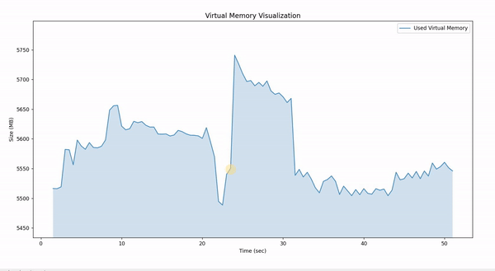
Results

Slide 6
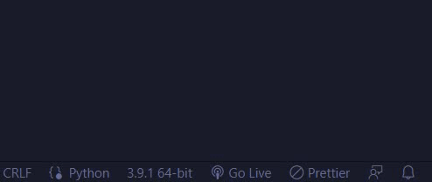
Warning for High Memory Usage

Slide 7
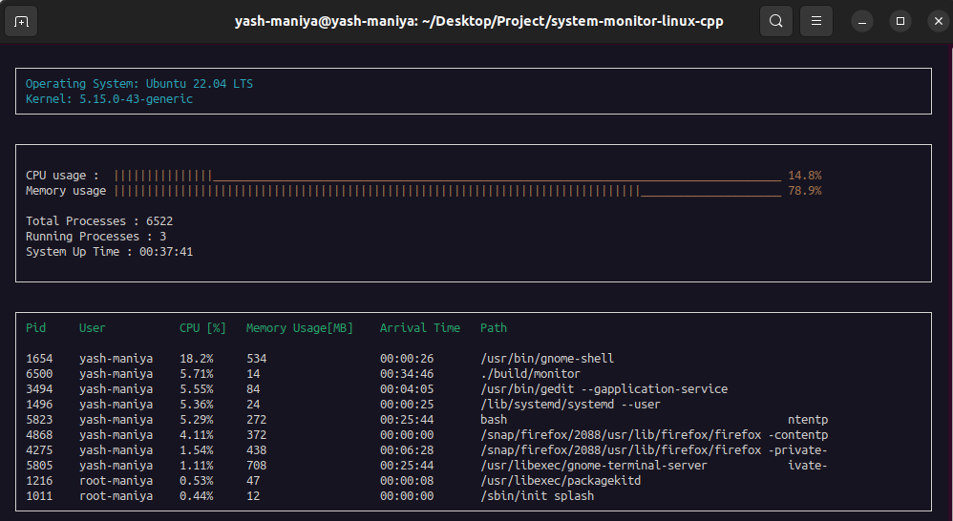
CPU utilization and Resources details

Slide 8

Conclusion
At the end, we can arrive at the conclusion that a real-time resource monitor is a great tool to examine our system's proper functioning.
It enables us to keep track of what is happening in our system's background so that we can stop the activity that might cause problems.
With little outside installation, these resource monitors maintain our system's cleanliness.

